Slide 1

Module 40: Task UI: Creating a Task
0/5
Siebel 8.0 Essentials
Notes:
Time: Lecture: <n – n> minutes; Labs: <n – n> minutes
Intent: <What is the instructional goal of the module>
Flow: < Describe at a high level the overall flow of the module>.
Key Terms: <List terms the instructor should be familiar with in order to teach this module>
<Term>
<Term>
<Term>
<Term>

Slide 2
Module Objectives
After completing this module you should be able to:
  Identify the major components of a task
  Configure a task
  Administer a task
Why you need to know:
  These are the steps to create and deploy a task
Notes:
Each objective and “why you need to know” should be stated aloud.

Slide 3
Creating a Task
Consists of the following activities:
  Configuring several types of Task UI components in Siebel Tools
  Deploying the task to the run-time client
  Administering the task in the run-time client

Slide 4
Components of a Task
0/3
Task Flow
Task View
Task Group
Notes:
This is a structuring slide for <insert what will be discussed>. Do not teach the steps or concepts here because the following slides cover them in detail. Provide a high level description of what will be discussed.

Slide 5
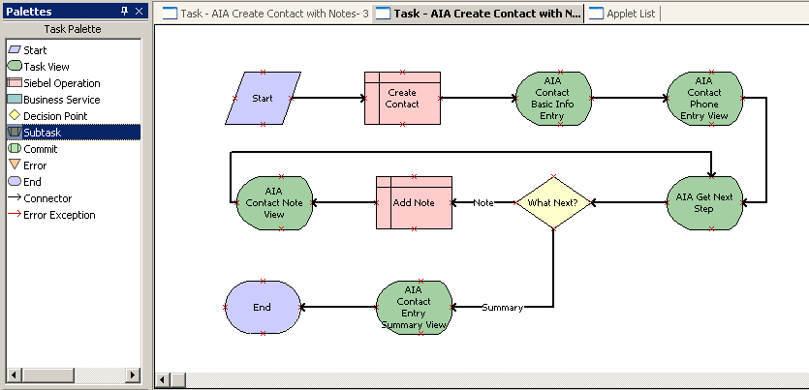
Task Flow
1/3
Specifies the flow of a task as a sequence of task steps
  Examples: Siebel operation, business service, and so on
Includes one or more task view steps that display a view to the user
Is configured in Siebel Tools using the Task Flow Designer
  Is a visual, declarative editor similar to the workflow designer

Slide 6
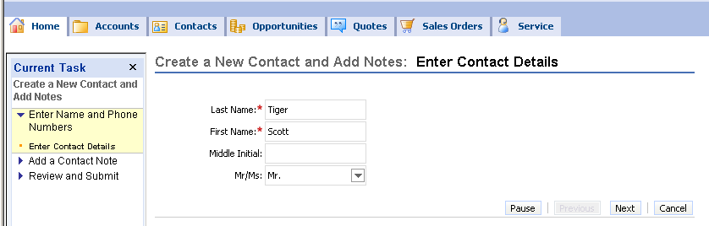
Task View
2/3
Is a special type of view used in a task
  Displays data to a user
  Allows user to enter data
  Allows user to navigate using the buttons in the Playbar applet
Consists of one or more applets and the Playbar applet
Is invoked in a task view step in a task flow

Slide 7
Task View Continued
2/3
Differs from standard views
  The view is not displayed in the context of a screen
  The user must use buttons in the Playbar applet to navigate
    Clicking any UI element outside the task view and task pane pauses the task and displays the prior standard Siebel view
  Applets in a task view do not have
    An applet menu
    The standard record controls such as New, Delete, and Query

Slide 8
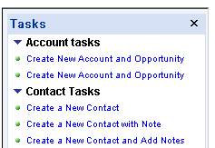
Task Group
3/3
Represents a collection of related tasks that can be displayed as a set in the task pane
Can be configured to be:
  Associated with a single standard view
  Available independent of the standard view
  Restricted to a single application
  Available across all applications
A task group
Another task group

Slide 9
Configuring a Task
0/9
1. Configure the Task Flow
2. Create Applets for Task Views
3. Configure the Task Views
4. Bind the Task Views
5. Configure Remaining Task Steps
6. Assign Chapters
Notes:
This is a structuring slide for <insert what will be discussed>. Do not teach the steps or concepts here because the following slides cover them in detail. Provide a high level description of what will be discussed.

Slide 10
Configuring a Task Continued
0/9
7. Create the Task Group
8. Compile the Configured Objects
9. Publish the Task Flow
Notes:
This is a structuring slide for <insert what will be discussed>. Do not teach the steps or concepts here because the following slides cover them in detail. Provide a high level description of what will be discussed.

Slide 11
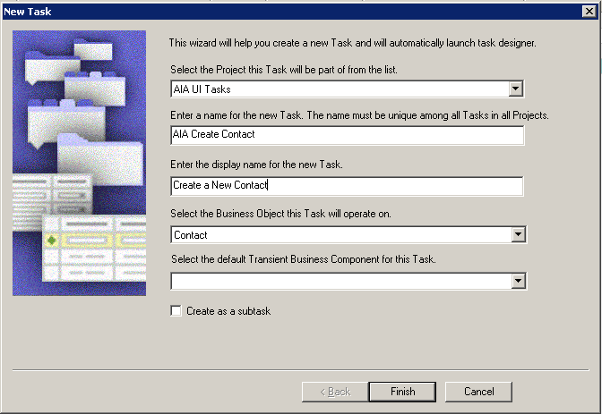
1. Configure the Task Flow
1/9
Use the Task Wizard to create a Task object
  Select File > New Object
  Select the Task Tab and click the Task icon
  Enter fields as below:
Name that appears in the task pane
Identifies the business object for this task

Slide 12
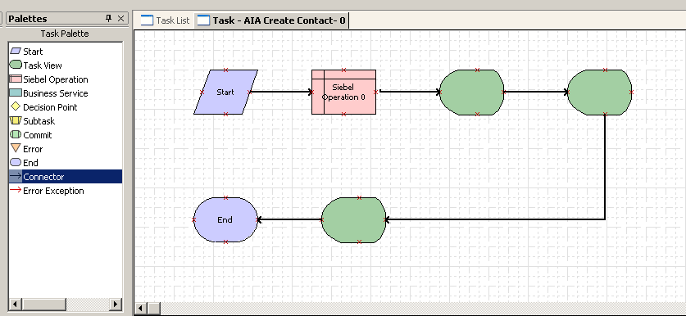
1. Configure the Task Flow Continued
1/9
In the task Designer, add steps as required
  Drag connectors and anchor them to the steps

Slide 13
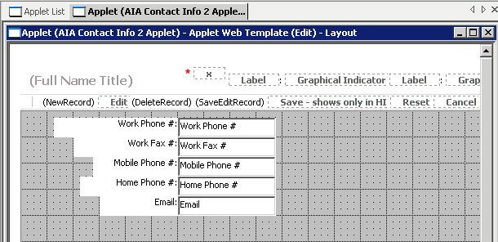
2. Create Applets for Task Views
2/9
Use the Form Applet Wizard to create applets that display a small set of focused data
Alternatively, copy an existing applet and delete the unnecessary fields

Slide 14
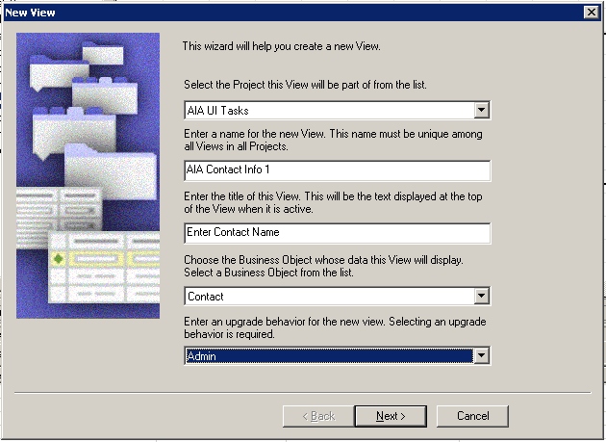
3. Configure the Task Views
3/9
Use the Task View Wizard to create one or more task views
  View objects with type = Task

Slide 15
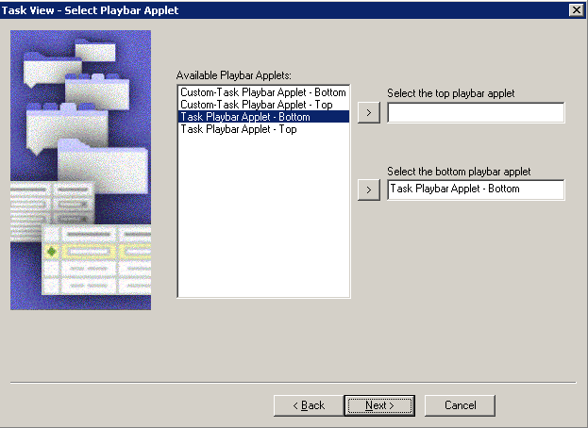
3. Configure the Task Views Continued
3/9
Select a view Web template
Assign one or more customized applets
Add the Playbar applet to the top and/or the bottom of the view

Slide 16
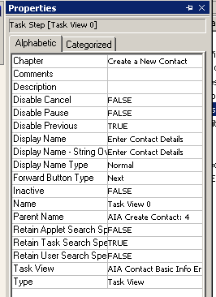
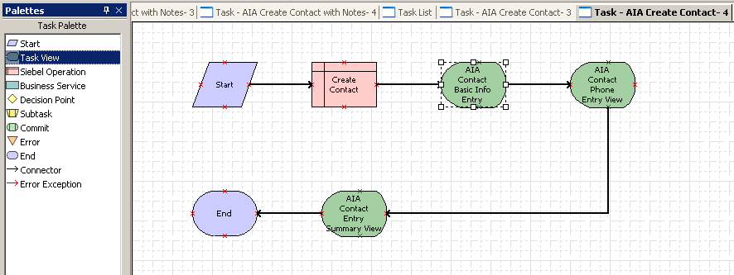
4. Bind the Task Views
4/9
For each task view step in the flow, assign a task view
  Right-click the task step and select Bind Task View
  Select the view from the list of available views
  Set the button properties for the view
Determines which buttons are disabled in a view
Set to Next for all but the final view

Slide 17
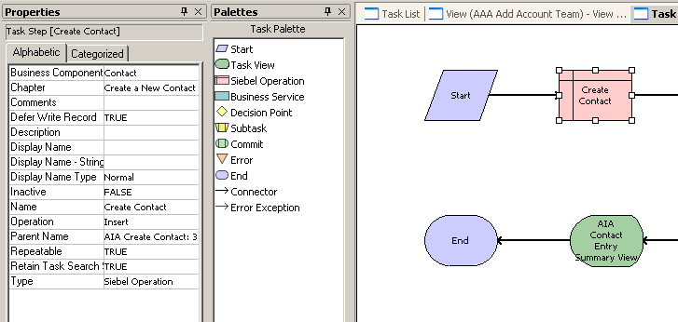
5. Configure Remaining Task Steps
5/9
Configure other types of steps such as:
  Siebel Operation
    Identify the business component and operation
    Set the Defer Write property to TRUE if necessary
  Decision Point step
    Set the conditions on each branch
Prevents Object Manager from rejecting the record because some required business component fields are not populated

Slide 18
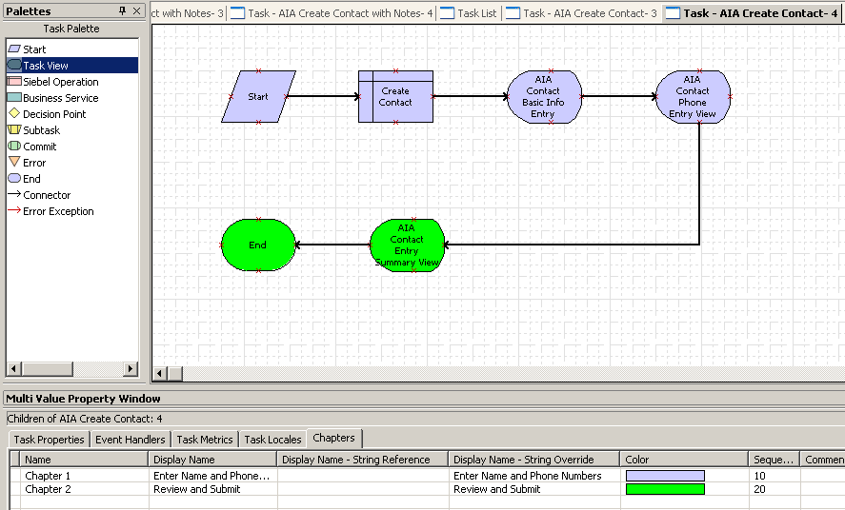
6. Assign Chapters
6/9
Optionally, create chapters to group steps in the task pane
Assign each step to a chapter
Assigned to chapter 1
Assigned to chapter 2

Slide 19
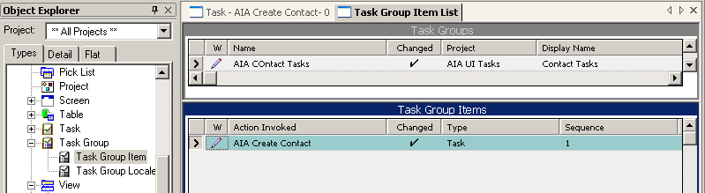
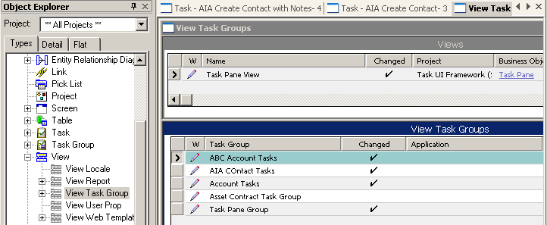
7. Create the Task Group
7/9
Assign the task to an existing (or new) task group
  Groups several tasks in the task pane
Assign the task group to a view
  Assign to the Task Pane View to make the tasks visible in all views
Assign task to task group
Assign task group to view
Assign to single application if required

Slide 20
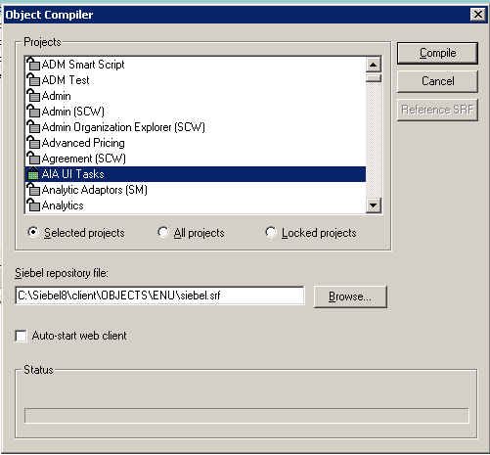
8. Compile the Configured Objects
8/9
Compile the configured objects into the target SRF file

Slide 21
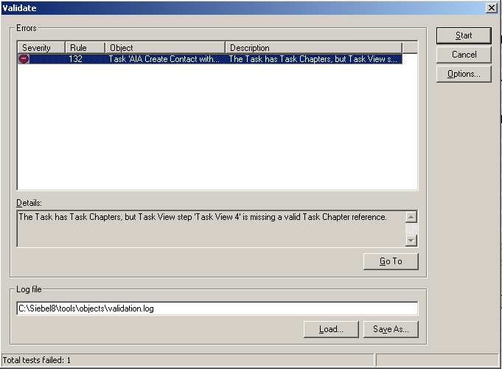
9. Publish the Task Flow
9/9
Validate the task flow to identify any possible errors
  Right-click and select Validate

Slide 22
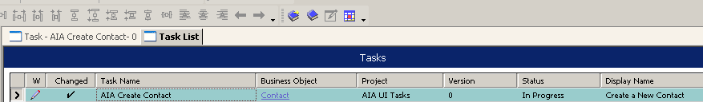
9. Publish the Task Flow Continued
9/9
Click the Publish button in the Deployment toolbar to deploy the task flow
  Sets the task flow to complete
  Makes it available for activation

Slide 23
Administering a Task
0/3
1. Activate the Task Flow
2. Register the Task Flow
3. Add Responsibilities
Notes:
This is a structuring slide for <insert what will be discussed>. Do not teach the steps or concepts here because the following slides cover them in detail. Provide a high level description of what will be discussed.

Slide 24
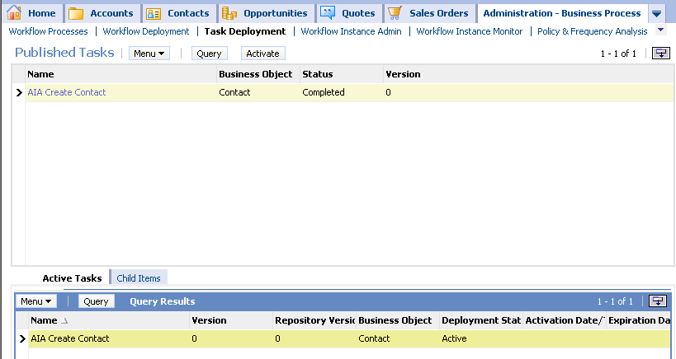
1. Activate the Task Flow
1/3
Navigate to Administration - Business Processes > Task Deployment
Select the published task and click Activate
  Makes the task available for use in the client
Alternatively, publish/activate directly from Siebel Tools

Slide 25
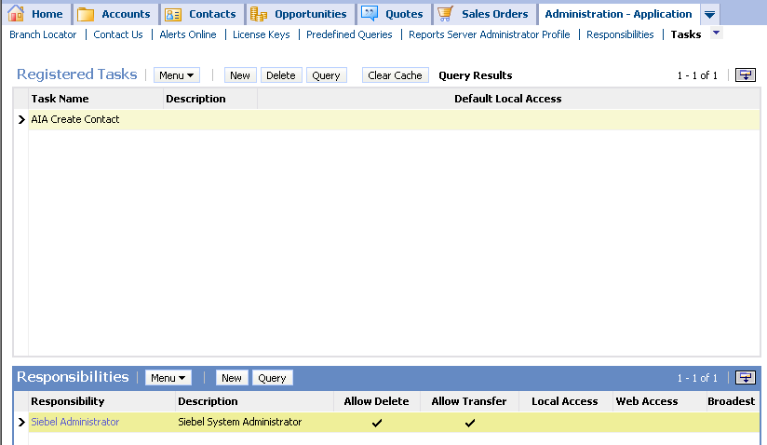
2. Register the Task Flow
2/3
Navigate to Application - Administration > Tasks
Create a new record and select the task from the list of published tasks

Slide 26
3. Add Responsibilities
3/3
Add one or more responsibilities to the registered task
  Allows users with the responsibility to see the task in the task pane
  Click Clear Cache to make the task immediately available
Adds task to the Siebel Administrator responsibility

Slide 27
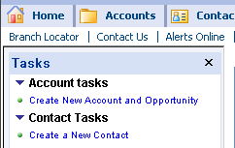
Testing the Deployment
Click the Tasks button to display the Task pane
Verify that the desired task appears
Click the task link and execute the task

Slide 28
Module Highlights
Creating a task in Siebel Tools consists of:
  Configuring a task flow
    Creating and binding task view steps
    Assigning steps to chapters
  Adding the task to a task group
  Assigning the task group to a view
  Publishing the task to the run-time client
Administering the task in the run-time client consists of:
  Activating the task
  Registering the task
  Adding the task to one or more responsibilities
Notes:
Review Question: <Question>
Answer: <Answer>

Slide 29
Lab
In the lab you will:
  Create a task
  Deploy and administer the task
Notes:
Labs and Troubleshooting:
<Summarize the tasks the students will perform in this lab. Suggest specific guidance the instructor may provide if necessary to help the students complete the lab and avoid trouble spots.>

